Slide 1
Distributed Services Dependency Discovery from Log
Project Proposer: Wenbo Qian
Mentors: Alison Yao

Slide 2
Problem:Building service dependencies is not easy
Traditional approaches are impractical in modern cloud systems
Documentation becomes outdated quickly and requires continuous maintenance.
Tracing across heterogeneous tech stacks demands heavy engineering effort.
Service context isn’t shared effectively across teams, hindering coordination.
Notes:
Traditional approaches to dependency mapping rely on static configuration files, manual documentation, or instrumented distributed tracing. However, these methods have significant limitations: configuration files drift from reality, documentation requires constant maintenance, and tracing instrumentation may be incomplete or unavailable in modern cloud systems.

Slide 3
Our approach: Automatically Building Services Dependency from logs
Timestamp | BOOT_ID | SYSLOG_IDENTIFIER | MESSAGE
20...247953Z | ef0…ac | kernel | veritysetup invoked oom-killer: gfp_mask=0xcc0(GFP_KERNEL)…
20... 250752Z | ef0…ac | kernel | …
2023-09-15T16:19:20.705592 | ef0…ac | kernel | oomkill:constraint=CONSTRAINT_MEMCG,nodemask=(null),cpuset=support.slice,mems_allowed=0,oom_memcg=/support.slice/RepairAgent.RepairAgent_23_9_7003_0.service,task_memcg=/support.slice/RepairAgent.RepairAgent_23_9_7003_0.service,task=RepairAgent,pid=3820648,uid=0
VeritySetup
Extract events and timestamps
Relationship analysis
2023-09-15T16:08:14. 247953
VeritySetup
happens-before
2023-09-15T16:19:20.705592
Repair Agent
…
Notes:
Basic idea is: Log include rich service interaction hints, nearly every service produces logs that contain implicit signals about inter-service communication: HTTP requests, RPC calls, database queries, and message queue interactions.

Slide 4


1. Agent-based events extraction
LLM
Output
system log
node log
[
{"
"service_a",
"operation_a",
"service_b",
"operation_b",
"resource",
"}
]
…
Events Extractor
Notes:
The second step is to extract all services interaction involved in the cross-service performance issue.
The challenge is: how to accurately reconstruct this hidden interaction from noisy text without requiring domain-specific instrumentation for every new service.
So we employs an agent-based interaction extractor to infer interactions between applications using logs and traces outputted from the Lightweight Anomaly Detector.
The output of this step will be a tuple means interaction type: (see slides)

Slide 5
2. Building Service Dependency
Service 2
Resource 1
Op 2.1
[
{"
"service_a",
"operation_a",
"service_b",
"operation_b",
"resource",
"},
…
]
Op 1.1
Service 1
Op 1.3
Resource 3
Op 3.2
Op 1.2
Service 3
Resource 2
Op 3.1

Slide 6
Challenge: Accuracy of Dependency Graph
LLM-extracted interactions may be inaccurate.
How can we verify that each dependency is truly supported by log evidence?
Problem
Missing or ambiguous log evidence Incorrect caller–callee relationships
Idea
Match extracted services with log lines Confirm interaction sequence

Slide 7
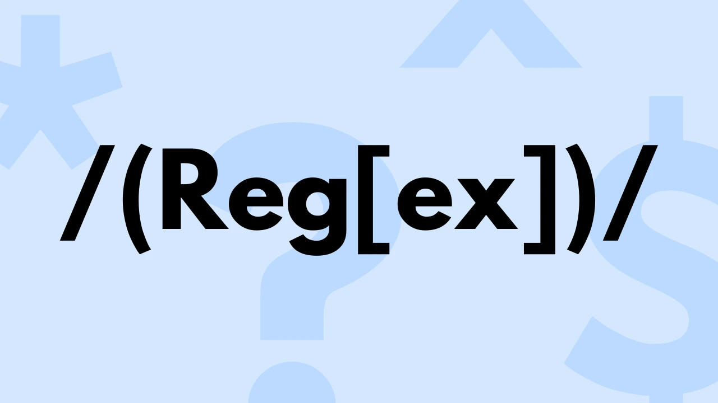


3. Dependency Checker
3.1 Check the existance of service interaction by using regular expression
3.2 check the service interaction casual relationship by time-series analysis

Slide 8
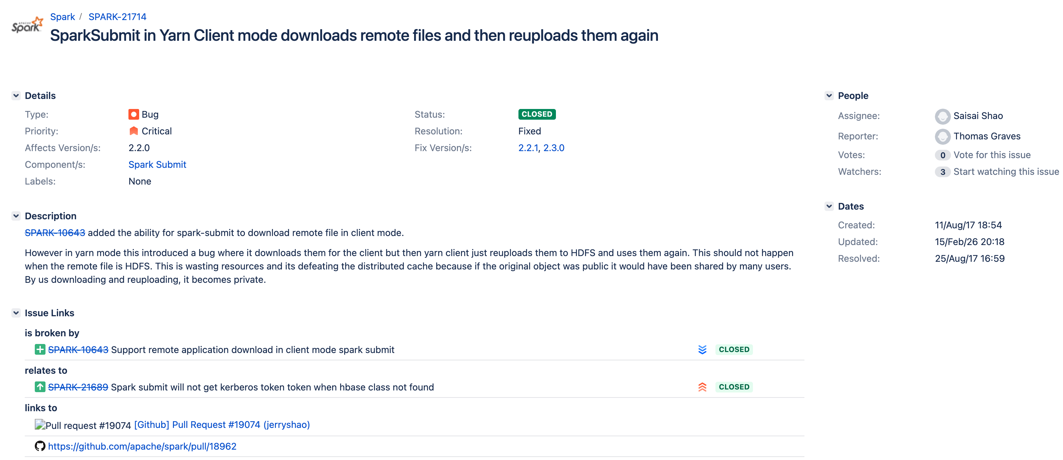
Preliminary Result

Slide 9
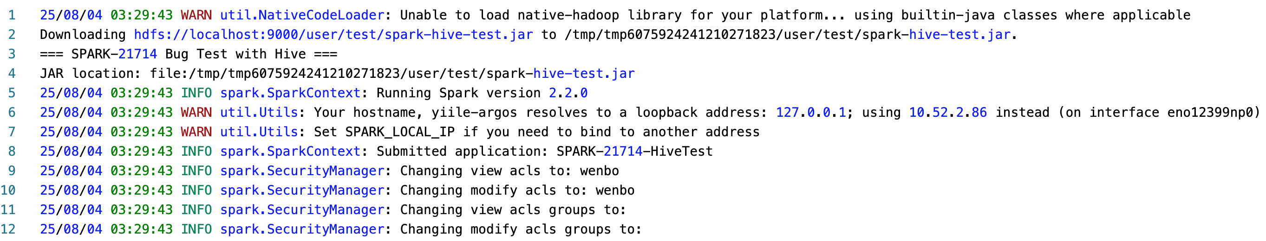
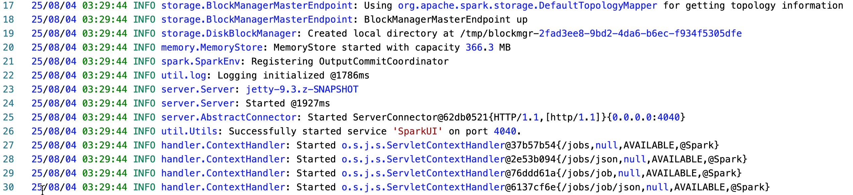
Preliminary Result

Slide 10
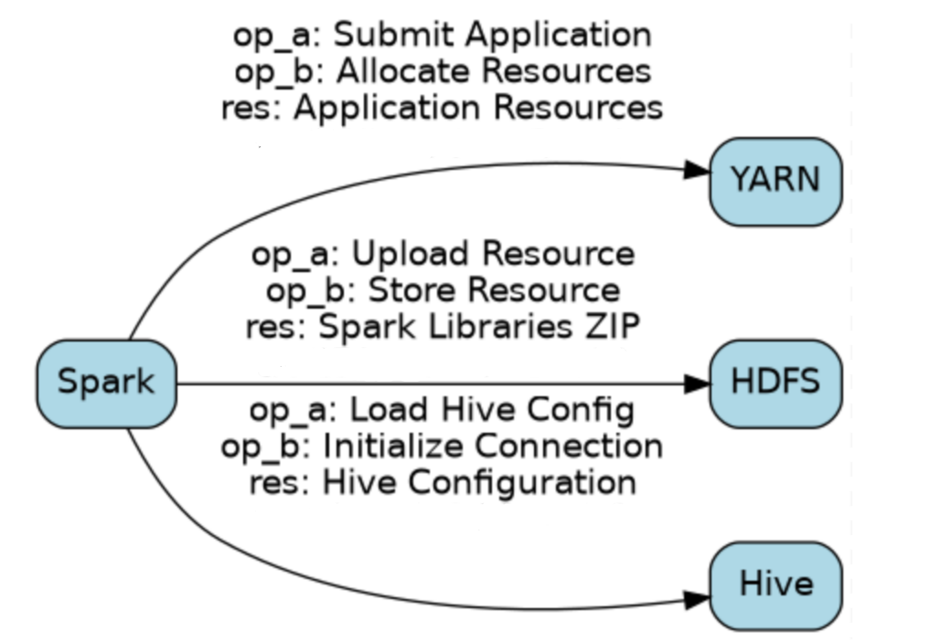
Preliminary Result

Slide 11
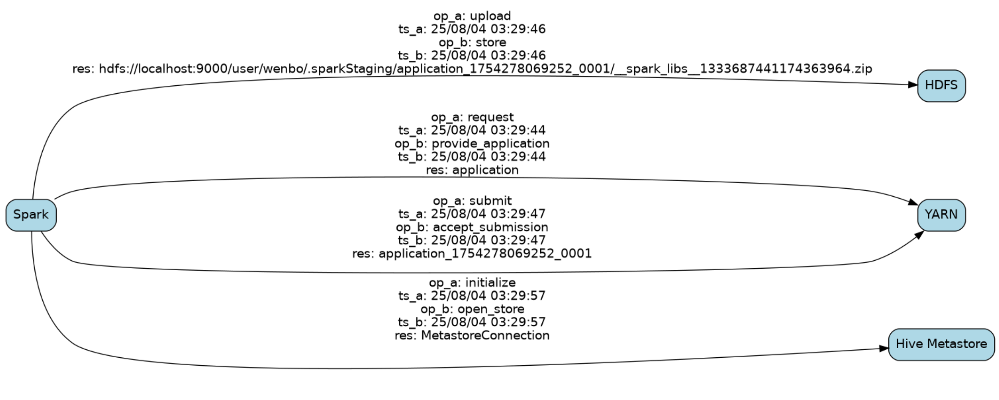
Preliminary Result

